Slide 1
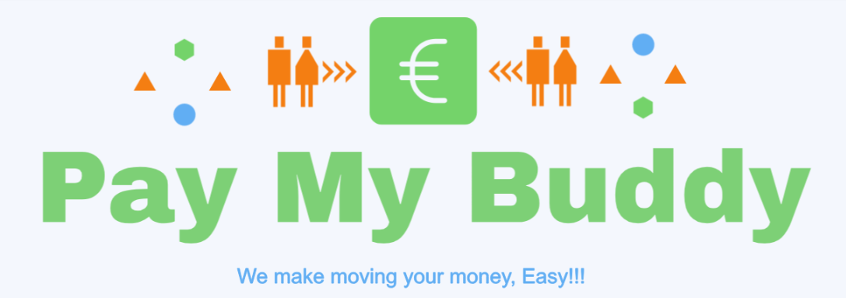
Project 6
Work with Databases to Create a Secure Web Application

Slide 2
Summary
Objective of the project
Problem to be solved
Solution
The technical stack of this application
Requirements/Features
SureFire Report
Jacoco Coverage Report

Slide 3
The main goal of the project is to develop an application that allows users to transfer money to others users.
Problem to be solved: Inconvenient transfer transactions ● Currently banks have a lengthy, inconvenient process to set up a money transfer. ● Bank transfers require too many details (account number, SWIFT codes, etc.) ● Difficult to quickly pay back or transfer money to friends or family.
Solution:
● Develop an app where users can register themselves easily with an email.
● Users can add friends to their network and transfer money among them.
● Simple design to streamline process, avoid hassles.

Slide 4
The technical stack of this application
Back-end logic
Java and Spring Boot Framework
Spring Security
Maven
Thymeleaf
Database management system
MySQL
Front-end design
HTML
CSS
JavaScript
Boostrap
jQuery – library
Deployment
Docker

Slide 5
Requirements/Features
● New users must be able to register using unique email id.
● Users should be able to login based on their accounts in the database.
● After login, users can add people to their lists by using their email (if the person already exists in the database).
● A user can load money into their account on our application.
● From the balance available, they can make payments to any other user registered with the application
● For each transaction, we charge a small fee of 0.5% to generate revenue for the company.

Slide 6
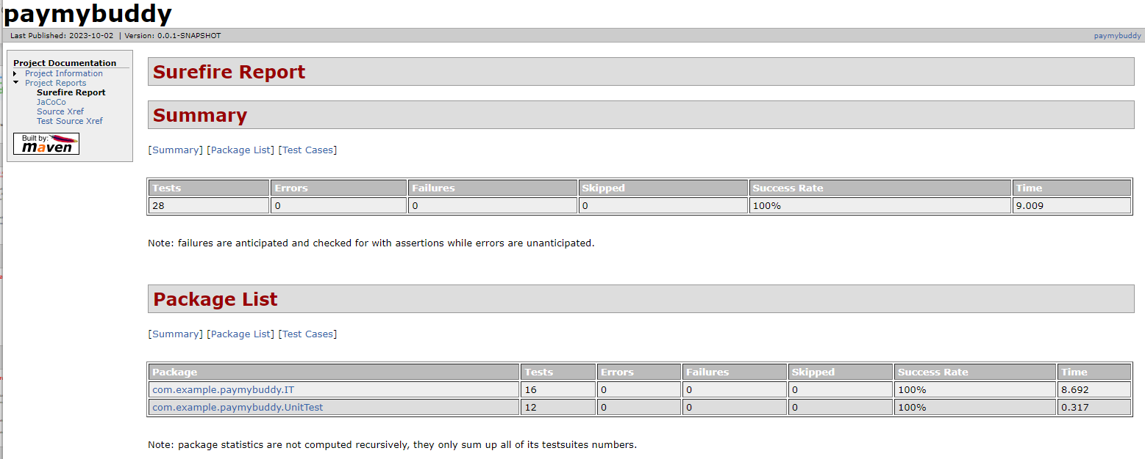
Surefire Report

Slide 7
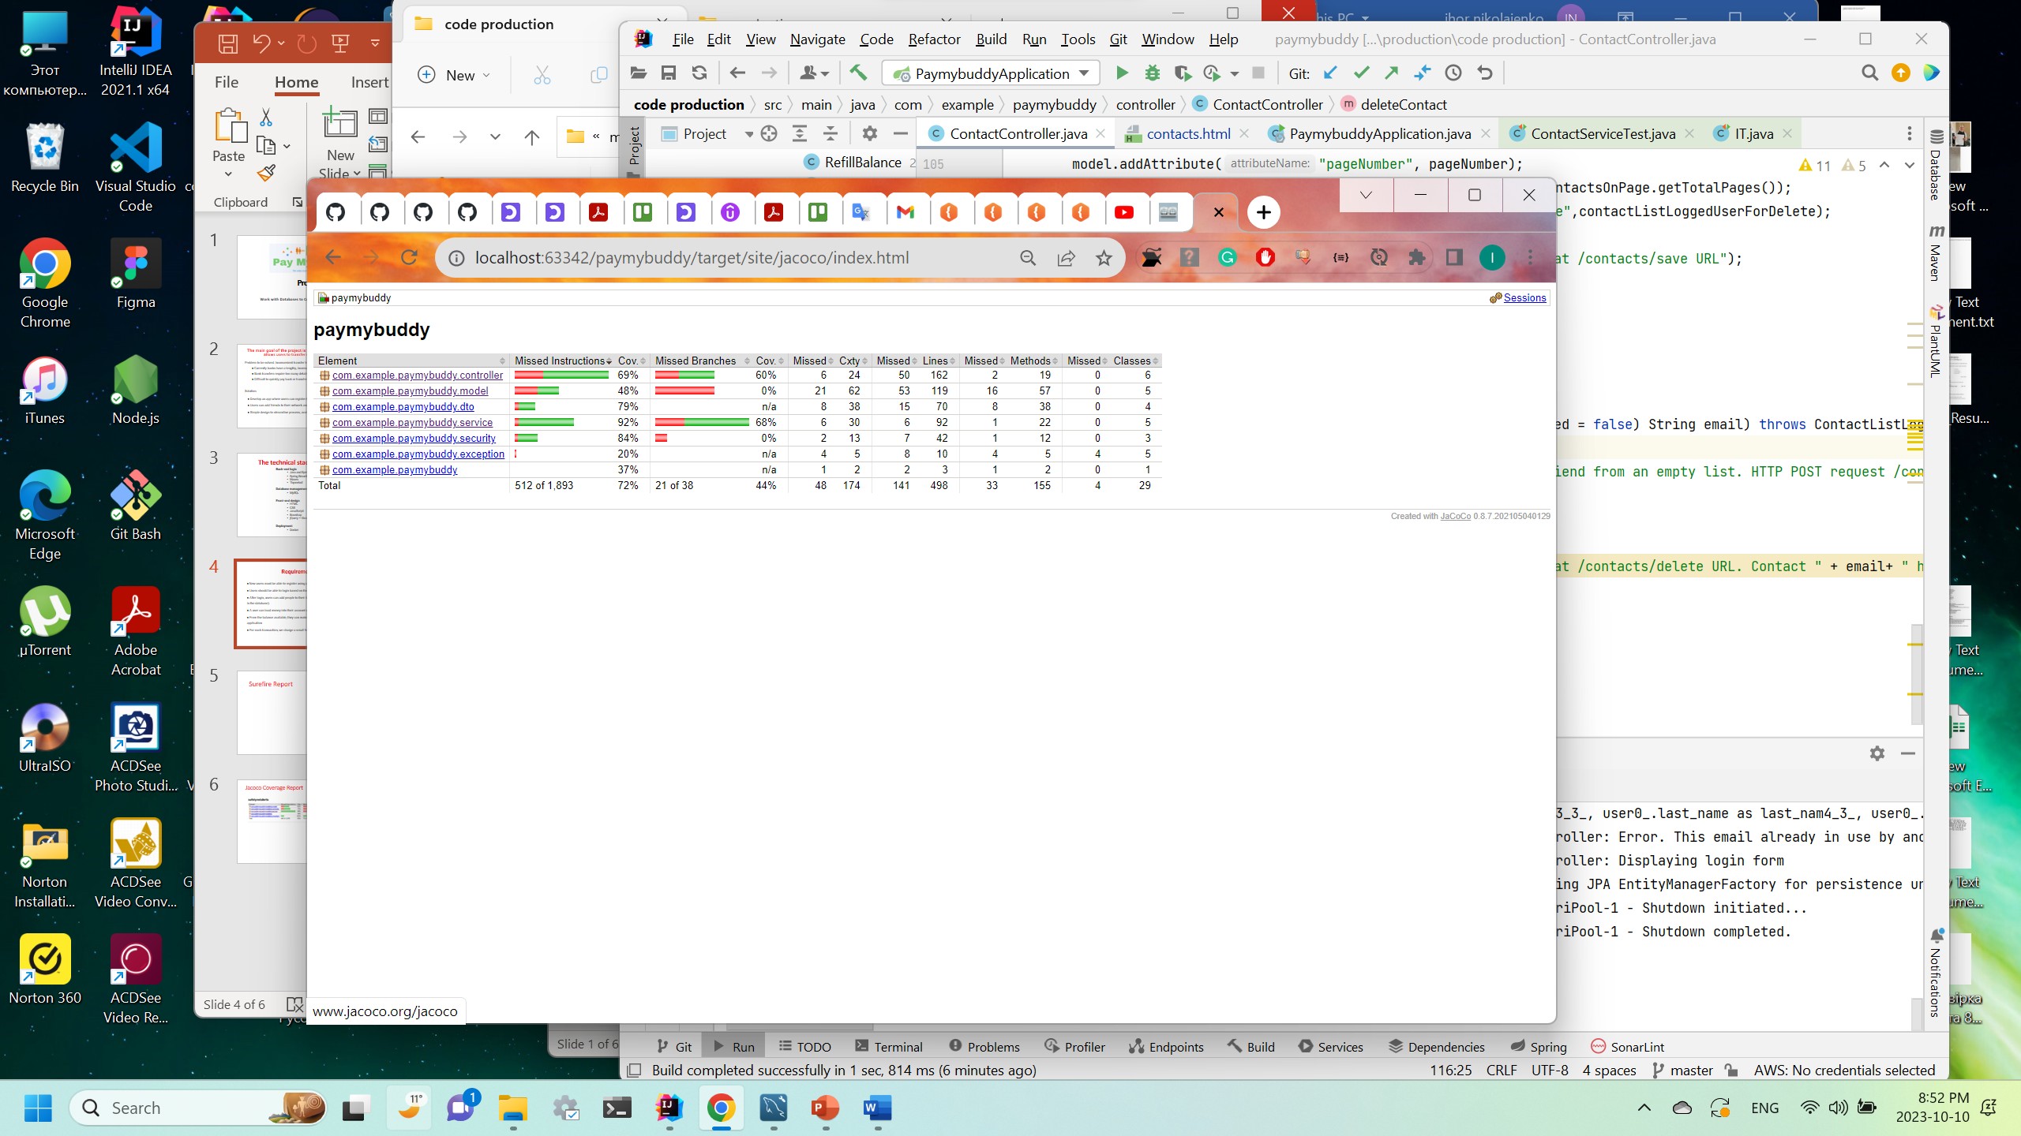
Jacoco Coverage Report

